Slide 2
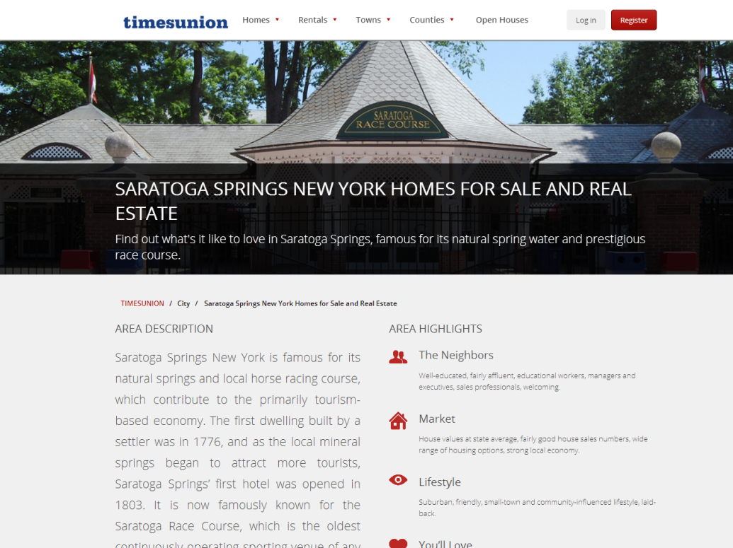
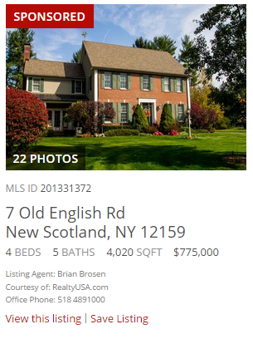
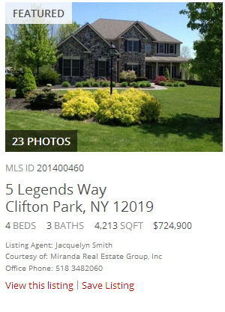
Premier Partner
Your choice of 1 community – based on availability
Newest listings featured (last 7 days) on TUReal Estate
10 Sponsored Listings per Month
In rotation 728x90 - Second position Ad
Monthly Investment
$399
Your Ad Here!

Slide 3
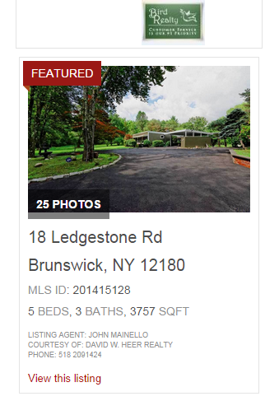
Platinum Level Agent
All listings featured in the Zip Code of your choice on the New TUReal Estate website
5 Spotlight Featured Properties
In “Premier Agent” rotation on TUReal Estate website
Included in 728x90 Ad rotation
Monthly Investment
$299
Your Ad Here!

Slide 4
Gold Level Agent
All listings featured in the Zip Code of your choice on the New TUReal Estate website
In “Premier Agent” rotation on TUReal Estate website
Monthly Investment
$189

Slide 5
Sponsored Listing
Within search listings pages, there is the ability to push certain listings to the top of the results. A Sponsored listing will always appear at the top of the listings page for any search that matches the users search criteria.
There are only two Sponsored listing slots available for each geographical search
Monthly Investment
$50

Slide 6
Spotlight Featured Listing
Spotlight Featured listings run in a prominent position on the right sidebar of the results pages based on the geographic search
Ads have the option of appearing on open house listings, community, search result, rentals and geographic search pages
You have the ability to purchase all ad space for a specific geographic area
Monthly Investment
$35

Slide 7
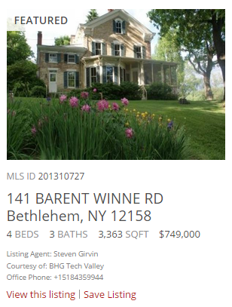
Featured Listings
Featured listings appear at the top of all search results pages based on the geographic search
Ads will only be pushed down if Sponsored Listings have been purchased
Monthly Investment
$25

Slide 8
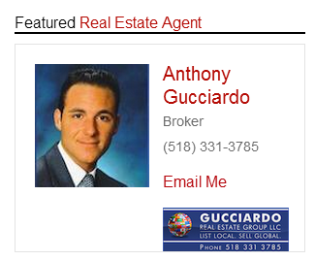
Featured Agent
Featured in the Zip Code of your choice on the New TUReal Estate website
Included in Homepage & TU.com Rotation
Monthly Investment
$50

Slide 9
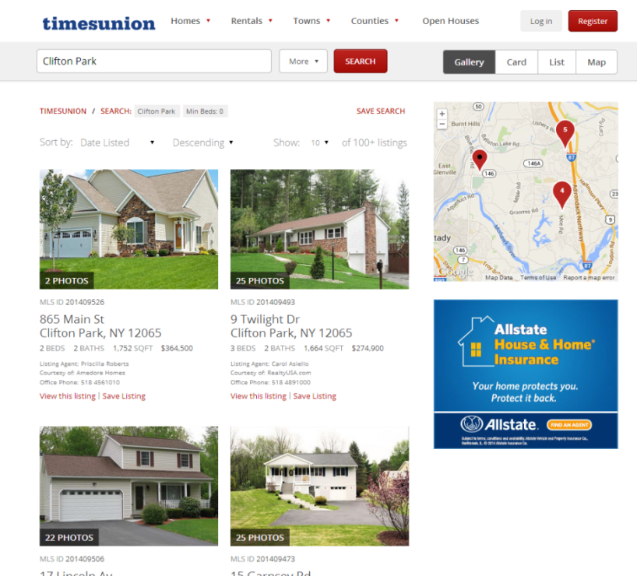
300x250
Highly Visible ad placed on the area’s #1 site for Home Buyers with over 2,000,000 page views monthly!
1 of 5 rotation
Monthly Investment
$300

Slide 10
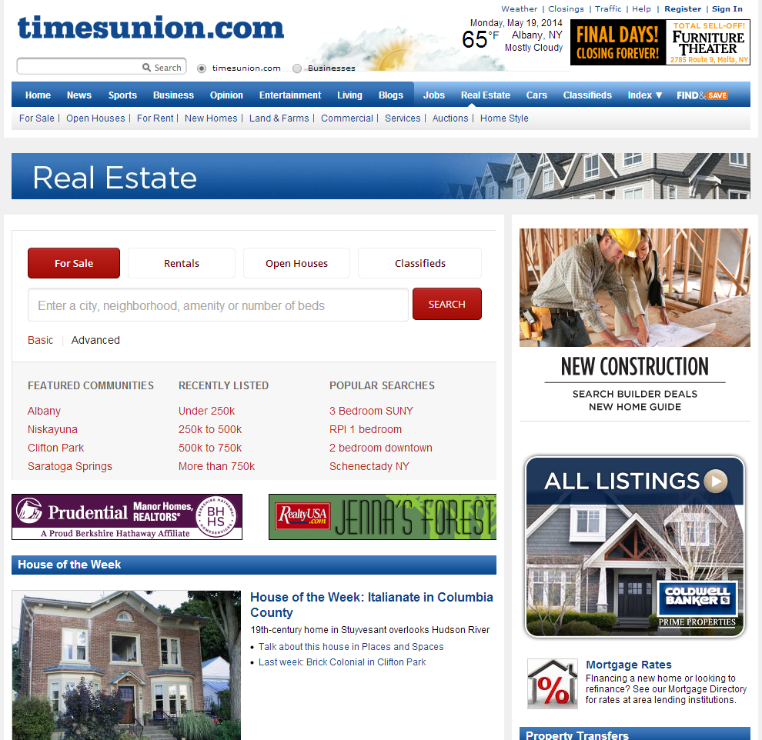
Expanding Pencil Ad
Highly Visible ad placed on the area’s #1 site for Home Buyers with over 500,000 page views monthly!
Monthly Investment
$1,500

Slide 11
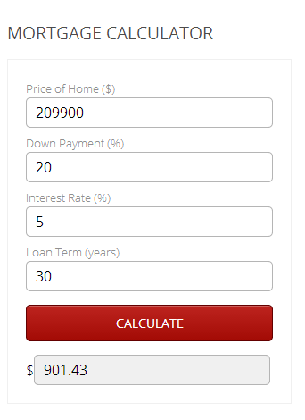
Premiere Lender
Sponsorship
Logo on all Mortgage Calculators
Appears on all Search Result Pages
Highly visible position shows you as the lender of choice for the region
Sponsored by:
Monthly Investment
$988

