Slide 1
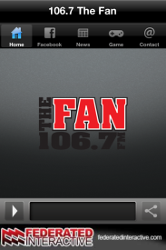
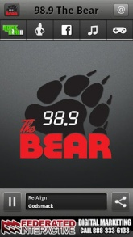
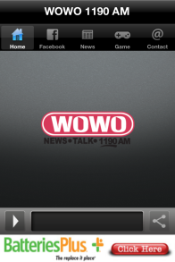
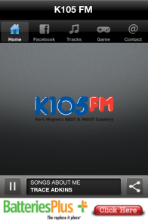
What is Internet Radio Advertising?
Internet radio listenership is growing at an amazing rate. eMarketer estimates that in 2012 over 46% of all 12+ internet users will listen to an internet radio station. That’s over 101 million people. That’s why our radio stations have responded to this growing trend. Each of our stations streams our broadcast signal through our radio station websites, Facebook pages and our iPhone and Android mobile apps. As a marketer in our community, you have an opportunity to purchase advertising in our internet radio station streams.
Benefits of Internet Radio Advertising
Advertisers who combine internet radio advertising along side their broadcast campaigns are
3 1/2 times more likely to see success than with broadcast alone. It makes sense. More and more consumers are going to the web to seek additional information before they purchase an item. If a listener hears your commercial through one of our internet radio station streams, they are right there to open a new window on their pc or browse your web site through their smart phone browser. Commercials that are run on our internet radio station streams can be entirely different than the spots you run on our broadcast channels.
Internet radio station advertising is a great way to promote your company’s web site or
mobile web site
Internet radio station advertising is also a great way to promote your company’s Facebook
page, Twitter account or other form of social media.
Internet radio station advertising will also help enhance your brand in the community.
Internet radio station advertising is VERY affordable.
Who’s Listening to our Internet Radio Stations?
EVERYONE! Well… practically. In the Fort Wayne area over 84,000 people are listening to our internet radio station streams in an average month. These listeners are coming back multiple times too. Currently our internet radio stations are listened to an average of 291,000 times per month with a total listening time of 310,000 hours. That’s over 1,860,000 minutes!

